Slide 1

C Programming
Dr Xiu ying Yu Department of Software Engineering School of Information Science and Technology email: xyyu@swjtu.edu.cn

Slide 2
C Programming
01: Introduction

Slide 3
Course Content
How to program in C?
How do we communicate with computers?
syntax
semantic
method
habit

Slide 4
Course Structure
40% Coursework+ 60% Examination
Four components:
Lectures for content delivery
Textbook for reference & practice exercises
Assignments for skills building & assessment
Labs hours for assistance

Slide 5
Lectures
3 lectures a week
Follow the textbook
But not slavishly
Notes:
地

Slide 6
Textbook

Slide 7
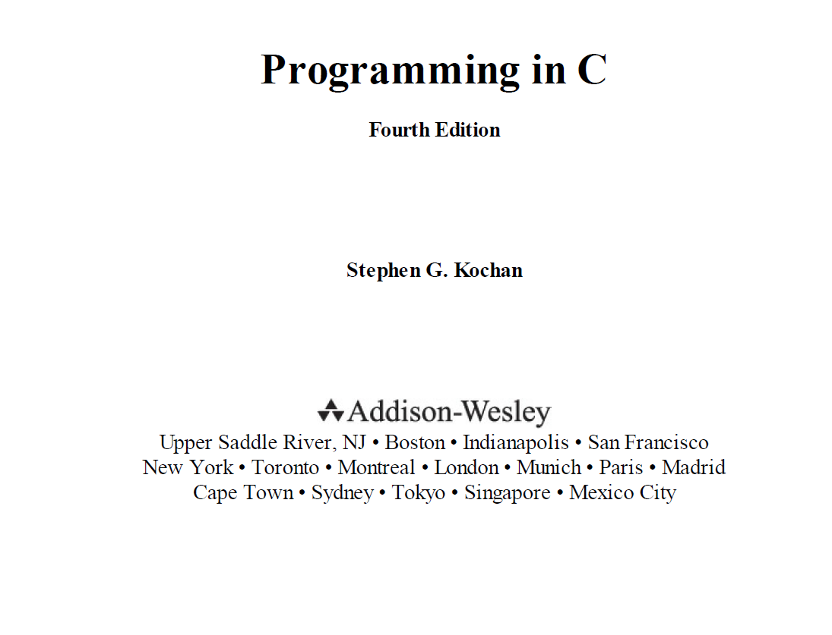
Textbook

Slide 8

Programming language
Chinese，English
010001011100
Programming language
Notes:
.

Slide 9
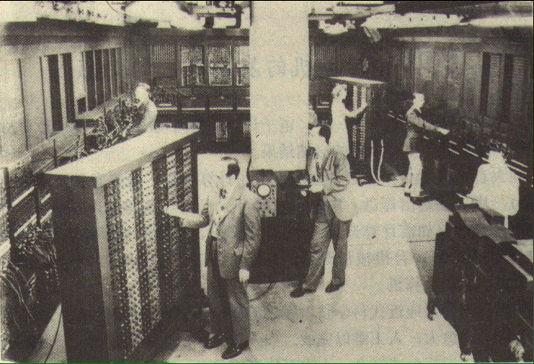
Programming language
In the early 1940s some scientists started building the ENIAC (Electronic Numerical Integrator and Calculator), which was completed by 1946.It is the first recognizably modern electrically powered computers.

Slide 10
Programming language
From Wiki:
A programming language is a formal language that specifies a set of instructions that can be used to produce various kinds of output.
Programming languages can be used to create programs that implement specific algorithms.

Slide 11
Programming language
Machine language (1G)
1010 1011 0011 0111
Assembly language (2G)
MOV A,47 ADD A,B
High-level programming language (3G)
FORTRAN, PASCAL, Basic, C...
Machine language
Assembly language
High-level programming language

Slide 12
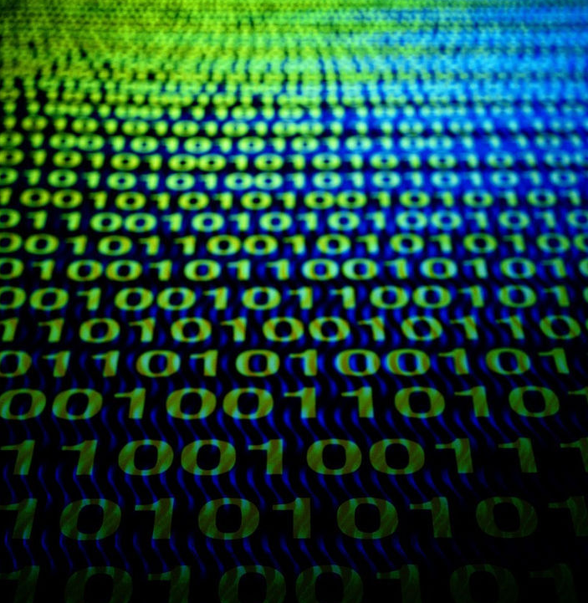
machine language
the set of symbolic instruction codes usually in binary form that is used to represent operations and data in a machine
1010 1011 0011 0111

Slide 13
Assembly language
easy for the programmers to understand
difficult for the machine to use
start of a trend

Slide 14
High-level programming language
In 1954, language FORTRAN was invented at IBM .
Over the years, a series of higher-level languages have been devised.
These languages attempt to let the programmer write in a medium that is easy for him to understand, and that is also precise and simple enough for the computer to understand.

Slide 15
High-level programming language
Early high-level languages were designed to handle specific types of applications.
FORTRAN was designed for number crunching
COBOL was for writing business reports
PASCAL was for student use.
Far outgrown their initial uses.
"If I had known that PASCAL was going to be so successful, I would have been more careful in its design. " --Nicklaus Wirth

Slide 16
Programming language
Some notable languages that were developed in this period include:
1968 – Logo 1969 – B (forerunner to C) 1970 – Pascal 1970 – Forth 1972 – C | 1972 – Smalltalk 1972 – Prolog 1973 – ML 1975 – Scheme 1978 – SQL (a query language, later extended)
In 1970 a programmer, Dennis Ritchie, created a new language called C.

Slide 17
Procedural Programming
A procedural language
a type of computer programming language that specifies a series of well-structured steps and procedures within its programming context to compose a program.
program blocks --functions

Slide 18
Procedural Programming
A sequence of instructions applied to variables:
Repetition (loops)
Conditional execution (ifs)
Mathematical & logical operations
Direct & indirect access to memory (pointers)

Slide 19
Procedural Programming
begin
function 1
output
function 2
end

Slide 20
Programming in C
Like most imperative languages in the
ALGOL tradition, C has facilities for
structured programming
allows lexical variable scope and recursion
a static type system prevents many unintended operations.

Slide 21
Programming in C
C is for the beginner
The systems programming language
The highest-performance language
The most irritating language
The source of viruses, hacks, & bugs
A crucial part of a computer scientist’s knowledge
And the language most others are built from

Slide 22
Programming in C
Compared with the other languages
Object Oriented Progrmaming (OOP)
C++(1980) , Java .

Slide 23
Being A Programmer
Programmers program (nearly) every day
It’s the bread and butter work
They need to do it:
efficiently
reliably
predictably
on time and under budget

Slide 24
Programming Habits
We will therefore also discuss good habits
Not required for programming
But habits that avoid problems
This means that you will be marked for:
Grammar - i.e. correctness
Structure - i.e. simplicity & design
Style - i.e. clarity & communication

Slide 25
Programming Process
Repeat
Choose the smallest possible task
Implement it in code
Extend it to a larger version
Reflect on its effectiveness
Rewrite for efficiency

Slide 26
How to Learn C
learn a lot more by writing and debugging programs than by reading
try to do as many exercises as possible.
keep good programming style in mind.
Always comment your programs

Slide 27
How to Learn C
For UNIX operating system users : a generic cc compiler or the Free Software Foundation's gcc compiler.
For MS-DOS/Windows users: Borland C++, Turbo C++, and Microsoft Visual C++.

Slide 28


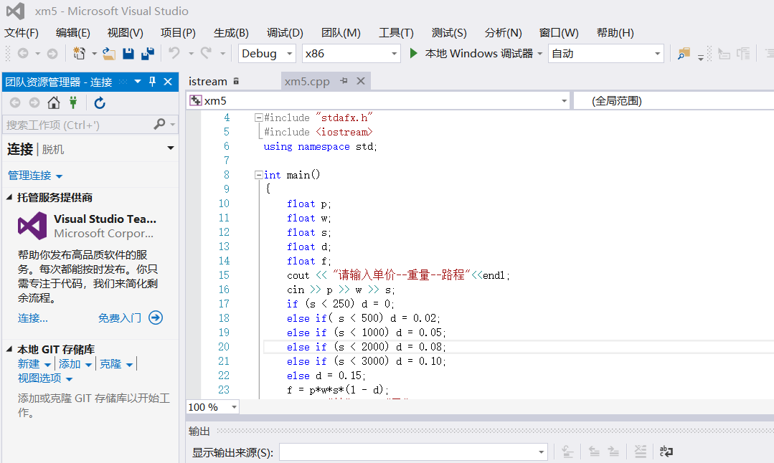
Integrated Development Environment
a free C, C++ IDE built to meet the most demanding needs of its users. It is designed to be very extensible and fully configurable.

Slide 29
Computer & programs
How they work?

Slide 30
Example: Averages
11
48
11
Copy number to working area
48
Copy number to working area
59
Add numbers to get a new one
59
÷
2
=
29.5
Divide by 2 to get another
or 29
Integer answer

Slide 31
Problems
Keeping track of which number to move
Where did the number 2 come from?
Do we want integer division or real numbers?
How is the computer supposed to know?
Let’s label the numbers
They are called variables and constants

Slide 32
Improvement
A
B
11
48
R1
11
Copy A to working area 1 (R1)
R2
48
Copy B to working area 2 (R2)
C
59
C = R1 + R2
D
2
E
E = C / D
59
÷
2
=
29.5
or 29
Copy E to output

Slide 33
More Systematic
addend1 = 11
addend2 = 48
sum = addend1+addend2
average = sum/howMany
Output average
This is “pseudocode”:
the logic of the computation implementation comes later
it is free form
and has no particular syntax

Slide 34
Worked Example
addend1 = ?? addend2 = ?? sum = ?? average = ??
addend1 = 11
addend1 = 11 addend2 = ?? sum = ?? average = ??
addend2 = 48
addend1 = 11 addend2 = 48 sum = ?? average = ??
sum = addend1+addend2
addend1 = 11 addend2 = 48 sum = 59 average = ??
average = sum/2
addend1 = 11 addend2 = 48 sum = 59 average = 30
Output average
This works out the right answer in advance
And provides a paper trace you can check against
Unless you made an error when you worked it out

Slide 35
Computer Architecture
We assume (for now) that we have:
a memory space with numeric byte addresses
data stored in memory
programs stored in memory
programs execute in linear sequence
unless the program says otherwise

Slide 36
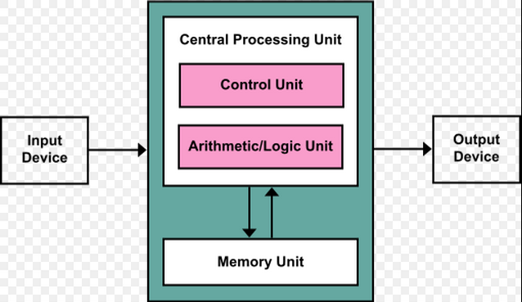
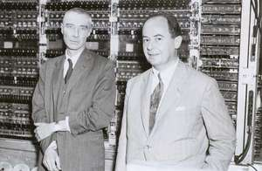
Computer Architecture
von Neumann Machine
John von Neumann
(1903-1957)
stored instructions as binary values
executed instructions sequentially
《introduction to computer 》-- for self study

Slide 37
Translation
So, we use C (or another language)
The machine uses machine code
We need to translate it
Read a file written in C
Write a file written in machine code
But that’s just another program . . .

Slide 38
Interpretation vs. Compilation
We can translate it as the human writes it
This is known as interpretation
And runs relatively slowly
Or write it all first, then transform all of it
This is known as compilation
And typically runs much faster

Slide 39
Compilation Stages
Code File
(.c)
Compilation
Object File
(.o)
Object File
(.o)
Object File
(.o)
Object File
(.o)
Linking
Object File
(.o)
Executable
Library
(.a)
Library
(.a)
Library
(.a)
Execution
Executable
Process

Slide 40
Basic of Program Writing
High-Level Code
Compiler
Assembly Language Program
Assembler
Object Code
Library
Linker
Executable Program

Slide 41
How C Works
error
Object
file
(obj)
Executable
file
(.exe)
Input code
compile
link
run
Source file
(.c/.cpp)
editor
compiler
Operating system

Slide 42
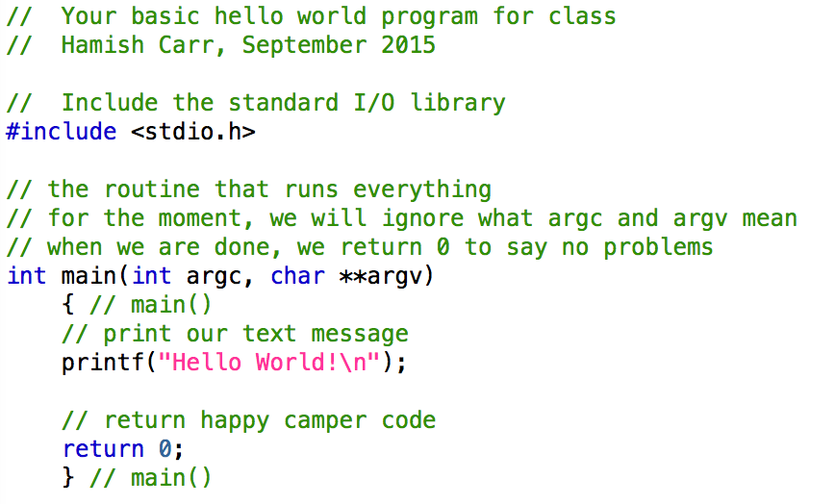
Programming Language (C)
comment
Macro command
main function

Slide 43
Comments
Comments are pieces of text in the code file
They have no logical meaning
They are the programmer’s semantic meaning
What you thought you were doing
Why you were doing it that way
Who did it (or modified it)
And they are crucial in practice

Slide 44
Linux Commands (*)
Compilation:
gcc -c -o helloworld.o helloworld.c
Linking:
gcc -o helloworld helloworld.o
Short-cut (both stages):
gcc -o helloworld helloworld.c
Execution
./helloworld

Slide 45
New Programs or Old?
Most programmers modify code
Sometimes they write new code
Then they go do something else
Then they come back to it
And often can’t understand it
Comments are how we resolve this

Slide 46
Recommended Style
Work out the computation on paper first
Build pseudocode to express the idea
Enter pseudocode in comments
Expand each piece of pseudocode into text
Print out intermediate results
And compare to execution trace

Slide 47
Algorithms
In computer systems, an algorithm is basically an instance of logic written in software by software developers to be effective for the intended "target" computer(s) to produce output from given (perhaps null) input.
Algorithm + Data Structures = Programs
-- Niklaus Wirth

Slide 48
Algorithms
Algorithms can be expressed in many kinds of notation, including
natural languages
pseudocode
flowcharts
programming languages or control tables (processed by interpreters)

Slide 49
Flow chart
Terminal
Beginning or ending of a program or sub-process. Represented as a stadium, oval or rounded (fillet) rectangle. They usually contain the word "Start" or "End", or another phrase signaling the start or end of a process.

Slide 50
Flow chart
Input/Output
Input and output of data, as in entering data or displaying results. Represented as a parallelogram.
Notes:
平行四边形 Parallelogram [ˌpærəˈlɛləˌɡræm]

Slide 51
Flow chart
Decision
Conditional operation determining which of two paths the program will take. The operation is commonly a yes/no question or true/false test. Represented as a diamond .

Slide 52
Flow chart
Process
Set of operations that change value, form, or location of data. Represented as a rectangle.

Slide 53
Flow chart
Flowline (Arrowhead)
Shows the program’s order of operation. A line coming from one symbol and ending at another. Arrowheads are added if the flow is not the standard top-to-bottom, left-to right.

Slide 54
flowchart
Annotation
(Comment)
Additional information about a step the program. Represented as an open rectangle with a dashed or solid line connecting it to the corresponding symbol in the flowchart.

Slide 55
Flow chart
On-page Connector
Pairs of labeled connectors replace long or confusing lines on a flowchart page. Represented by a small circle with a letter inside.

Slide 56
Flow chart
Example
Input a and b,
calculates the result of the addition
c=a+b

Slide 57
Flow chart
Example
calculates the root ( s) of the quadratic equation
ax²+bx+c=0
b²-4ac<0 no root
b²-4ac>0 2 different roots
b²-4ac=0 1root

Slide 58
Start
Input a,b,c
△←b²-4ac
T
F
△≥0
T
△>0
F
x1←(-b+sqrt(b*b-4ac))/(2a)
x2←(-b-sqrt(b*b-4ac))/(2a)
x1←-b/(2a)
x2←x1
Output “is not quadratic”
Output x1,x2
End

Slide 59
exercise
[ex.1] Compute the cost of baggage carried by train. Input the weight of the baggage, compute the cost. Draw the flowchart.
standard of cost：
(1) lighter than 50 kg(include 50 kg)，
$ 3 /kg
(2) over weight than 50 kg，50 kg like (1)，the other excess, $5 /kg
analysis cost | not overweight 3*weight
 | overweight 3*50+5*(weight-50）

Slide 60
exercise
[ex.2] 《introduction to computer 》 -- for self study

